Slide 1
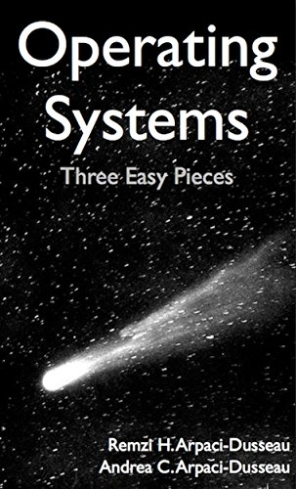
Computer Operating Systems BLG 312E Week -2
Prof. Dr. Kemal Bıçakcı

Slide 2
Review of Last Week

Slide 3
Some History
Early Operating Systems: Just Libraries
Batch Processing
Beyond Libraries: Protection
System calls (trap and return-from-trap instructions)
The Era of Multiprogramming
Memory protection
Concurrency issues
The Modern Era
mainframe → minicomputer → PC

Slide 4
The Importance of UNIX
Influenced by earlier Multics system from MIT
Providing a compiler for the new C programming language
The spread of UNIX was slowed because of lawyers getting involved
Windows was introduced and took over much of the PC market (a great leap backwards)
Then, came Linux
Mac OS X/macOS has UNIX at its core
Windows has similarly adopted many of the great ideas

Slide 5
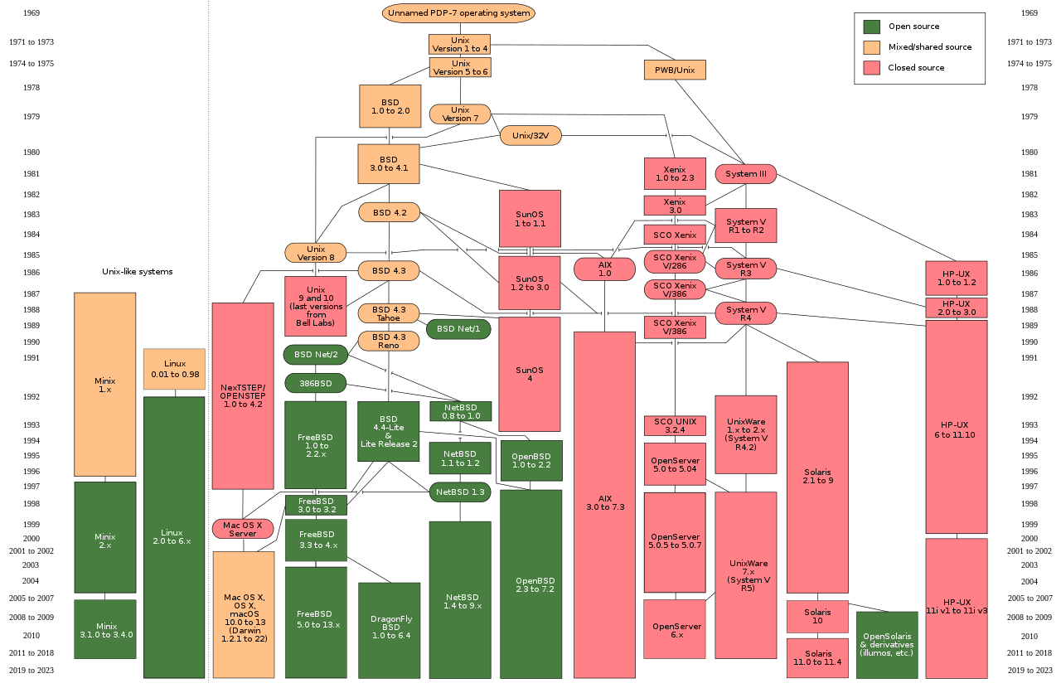

Slide 6
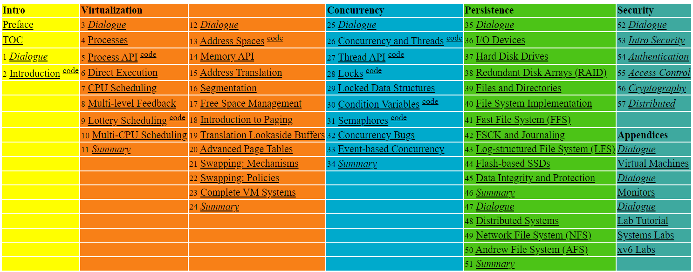

Slide 7
4. The Abstraction: The Process
Operating System: Three Easy Pieces

Slide 8
How to provide the illusion of many CPUs?
CPU virtualizing
The OS can promote the illusion that many virtual CPUs exist.
Time sharing: Running one process, then stopping it and running another
The potential cost is performance.

Slide 9
A Process
Comprising of a process:
Memory (address space)
Instructions
Data section
Registers
Program counter
Stack pointer
A process is a running program.

Slide 10
How do we translate «Process» into Turkish?

Slide 11
Process API
These APIs are available on any modern OS (more on this later)
Create
Create a new process to run a program
Destroy
Halt a runaway process
Wait
Wait for a process to stop running
Miscellaneous Control
Some kind of method to suspend a process and then resume it
Status
Get some status info about a process

Slide 12
Process Creation
Load a program code into memory, into the address space of the process.
Programs initially reside on disk in executable format.
OS perform the loading process lazily.
Loading pieces of code or data only as they are needed during program execution.
The program’s run-time stack is allocated.
Use the stack for local variables, function parameters, and return address.
Initialize the stack with arguments → argc and the argv array of main() function

Slide 13
Process Creation (Cont.)
The program’s heap is created.
Used for explicitly requested dynamically allocated data.
Program request such space by calling malloc()and free it by calling free().
The OS do some other initialization tasks.
input/output (I/O) setup
Each process by default has three open file descriptors.
Standard input, output and error
Start the program running at the entry point, namely main().
The OS transfers control of the CPU to the newly-created process.

Slide 14
Loading: From Program To Process
CPU
Memory
code
static data
heap
stack
Process
Loading:
Takes on-disk program
and reads it into the address space of process
code
static data
Program
Disk

Slide 15
Process States
A process can be one of three states:
Running
A process is running on a processor.
Ready
A process is ready to run but for some reason the OS has chosen not to run it at this given moment.
Blocked
A process has performed some kind of operation.
When a process initiates an I/O request to a disk, it becomes blocked and thus some other process can use the processor.

Slide 16
Process State Transition
Running
Ready
Descheduled
Scheduled
I/O: initiate
I/O: done
Blocked

Slide 17
Data structures
The OS has some key data structures that track various relevant pieces of information.
Process list
Ready processes
Blocked processes
Current running process
Register context
PCB (Process Control Block)
A C-structure that contains information about each process.

Slide 18
Example: The xv6 kernel Proc Structure
// the registers xv6 will save and restore
// to stop and subsequently restart a process
struct context {
int eip; // Index pointer register
int esp; // Stack pointer register
int ebx; // Called the base register
int ecx; // Called the counter register
int edx; // Called the data register
int esi; // Source index register
int edi; // Destination index register
int ebp; // Stack base pointer register
};
// the different states a process can be in
enum proc_state { UNUSED, EMBRYO, SLEEPING,
RUNNABLE, RUNNING, ZOMBIE };

Slide 19
Example: The xv6 kernel Proc Structure (Cont.)
// the information xv6 tracks about each process
// including its register context and state
struct proc {
char *mem; // Start of process memory
uint sz; // Size of process memory
char *kstack; // Bottom of kernel stack
// for this process
enum proc_state state; // Process state
int pid; // Process ID
struct proc *parent; // Parent process
void *chan; // If non-zero, sleeping on chan
int killed; // If non-zero, have been killed
struct file *ofile[NOFILE]; // Open files
struct inode *cwd; // Current directory
struct context context; // Switch here to run process
struct trapframe *tf; // Trap frame for the
// current interrupt
};

Slide 20
5. Interlude: Process API
Operating System: Three Easy Pieces

Slide 21
The fork() System Call
Create a new process
The newly-created process has its own copy of the address space, registers, and PC.
p1.c
#include <stdio.h>
#include <stdlib.h>
#include <unistd.h>
int main(int argc, char *argv[]){
printf("hello world (pid:%d)\n", (int) getpid());
int rc = fork();
if (rc < 0) { // fork failed; exit
fprintf(stderr, "fork failed\n");
exit(1);
} else if (rc == 0) { // child (new process)
printf("hello, I am child (pid:%d)\n", (int) getpid());
} else { // parent goes down this path (main)
printf("hello, I am parent of %d (pid:%d)\n",
rc, (int) getpid());
}
return 0;
}

Slide 22
Calling fork() example (Cont.)
Result (Not deterministic)
prompt> ./p1
hello world (pid:29146)
hello, I am parent of 29147 (pid:29146)
hello, I am child (pid:29147)
prompt>
or
prompt> ./p1
hello world (pid:29146)
hello, I am child (pid:29147)
hello, I am parent of 29147 (pid:29146)
prompt>

Slide 23
The wait() System Call
This system call won’t return until the child has run and exited.
p2.c
#include <stdio.h>
#include <stdlib.h>
#include <unistd.h>
#include <sys/wait.h>
int main(int argc, char *argv[]){
printf("hello world (pid:%d)\n", (int) getpid());
int rc = fork();
if (rc < 0) { // fork failed; exit
fprintf(stderr, "fork failed\n");
exit(1);
} else if (rc == 0) { // child (new process)
printf("hello, I am child (pid:%d)\n", (int) getpid());
} else { // parent goes down this path (main)
int wc = wait(NULL);
printf("hello, I am parent of %d (wc:%d) (pid:%d)\n",
rc, wc, (int) getpid());
}
return 0;
}

Slide 24
The wait() System Call (Cont.)
Result (Deterministic)
prompt> ./p2
hello world (pid:29266)
hello, I am child (pid:29267)
hello, I am parent of 29267 (wc:29267) (pid:29266)
prompt>

Slide 25
The exec() System Call
Run a program that is different from the calling program
p3.c
#include <stdio.h>
#include <stdlib.h>
#include <unistd.h>
#include <string.h>
#include <sys/wait.h>
int main(int argc, char *argv[]){
printf("hello world (pid:%d)\n", (int) getpid());
int rc = fork();
if (rc < 0) { // fork failed; exit
fprintf(stderr, "fork failed\n");
exit(1);
} else if (rc == 0) { // child (new process)
printf("hello, I am child (pid:%d)\n", (int) getpid());
char *myargs[3];
myargs[0] = strdup("wc"); // program: "wc" (word count)
myargs[1] = strdup("p3.c"); // argument: file to count
myargs[2] = NULL; // marks end of array
…

Slide 26
The exec() System Call (Cont.)
p3.c (Cont.)
…
execvp(myargs[0], myargs); // runs word count
printf("this shouldn’t print out");
} else { // parent goes down this path (main)
int wc = wait(NULL);
printf("hello, I am parent of %d (wc:%d) (pid:%d)\n",
rc, wc, (int) getpid());
}
return 0;
}
Result
prompt> ./p3
hello world (pid:29383)
hello, I am child (pid:29384)
29 107 1030 p3.c
hello, I am parent of 29384 (wc:29384) (pid:29383)
prompt>

Slide 27
Why fork()/exec() combination?
why would we build such an odd interface to what should be the simple act of creating a new process?

Slide 28
All of the above with redirection
p4.c
#include <stdio.h>
#include <stdlib.h>
#include <unistd.h>
#include <string.h>
#include <fcntl.h>
#include <sys/wait.h>
int
main(int argc, char *argv[]){
int rc = fork();
if (rc < 0) { // fork failed; exit
fprintf(stderr, "fork failed\n");
exit(1);
} else if (rc == 0) { // child: redirect standard output to a file
close(STDOUT_FILENO);
open("./p4.output", O_CREAT|O_WRONLY|O_TRUNC, S_IRWXU);
…

Slide 29
All of the above with redirection (Cont.)
p4.c
…
// now exec "wc"...
char *myargs[3];
myargs[0] = strdup("wc"); // program: "wc" (word count)
myargs[1] = strdup("p4.c"); // argument: file to count
myargs[2] = NULL; // marks end of array
execvp(myargs[0], myargs); // runs word count
} else { // parent goes down this path (main)
int wc = wait(NULL);
}
return 0;
}
Result
prompt> ./p4
prompt> cat p4.output
32 109 846 p4.c
prompt>

Slide 30
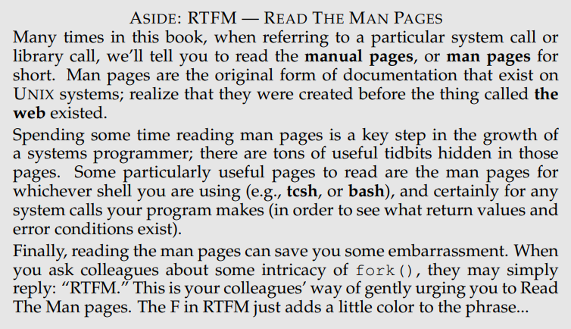

Slide 31
6. Mechanism: Limited Direct Execution
Operating System: Three Easy Pieces

Slide 32
«Limited Direct Execution» What is it?

Slide 33
How to efficiently virtualize the CPU with control?
The OS needs to share the physical CPU by time sharing.
Issue
Performance: How can we implement virtualization without adding excessive overhead to the system?
Control: How can we run processes efficiently while retaining control over the CPU?

Slide 34
Direct Execution
Just run the program directly on the CPU.
OS | Program
1. Create entry for process list 2. Allocate memory for program 3. Load program into memory 4. Set up stack with argc / argv 5. Clear registers 6. Execute call main() 9. Free memory of process 10. Remove from process list | 7. Run main() 8. Execute return from main()
Without limits on running programs,
the OS wouldn’t be in control of anything and
thus would be “just a library”

Slide 35
Problem 1: Restricted Operation
What if a process wishes to perform some kind of restricted operation such as
Issuing an I/O request to a disk
Gaining access to more system resources such as CPU or memory
Solution: Using protected control transfer
User mode: Applications do not have full access to hardware resources.
Kernel mode: The OS has access to the full resources of the machine

Slide 36
System Call
Allow the kernel to carefully expose certain key pieces of functionality to user program, such as
Accessing the file system
Creating and destroying processes
Communicating with other processes
Allocating more memory

Slide 37
System Call (Cont.)
Trap instruction
Jump into the kernel
Raise the privilege level to kernel mode
Return-from-trap instruction
Return into the calling user program
Reduce the privilege level back to user mode

Slide 38
Limited Direction Execution Protocol
OS @ boot
(kernel mode)
Hardware
initialize trap table
remember address of …
syscall handler
OS @ run
(kernel mode)
Hardware
Program
(user mode)
Create entry for process list
Allocate memory for program
Load program into memory
Setup user stack with argv
Fill kernel stack with reg/PC
return-from -trap
restore regs from kernel stack
move to user mode
jump to main
Run main()
…
Call system
trap into OS

Slide 39
Limited Direction Execution Protocol (Cont.)
OS @ run
(kernel mode)
Hardware
Program
(user mode)
(Cont.)
save regs to kernel stack
move to kernel mode
jump to trap handler
Handle trap
Do work of syscall
return-from-trap
restore regs from kernel stack
move to user mode
jump to PC after trap
…
return from main
trap (via exit())
Free memory of process
Remove from process list

Slide 40
Problem 2: Switching Between Processes
How can the OS regain control of the CPU so that it can switch between processes?
A cooperative Approach: Wait for system calls
A Non-Cooperative Approach: The OS takes control

Slide 41
A Cooperative Approach: Wait for system calls
Processes periodically give up the CPU by making system calls such as yield.
The OS decides to run some other task.
Application also transfer control to the OS when they do something illegal.
Divide by zero
Try to access memory that it shouldn’t be able to access
Example: Early versions of the Macintosh OS, The old Xerox Alto system
A process gets stuck in an infinite loop.
→ Reboot the machine

Slide 42
A Non-Cooperative Approach: OS Takes Control
A timer interrupt
During the boot sequence, the OS start the timer.
The timer raise an interrupt every so many milliseconds.
When the interrupt is raised :
The currently running process is halted.
Save enough of the state of the program
A pre-configured interrupt handler in the OS runs.
A timer interrupt gives OS the ability to
run again on a CPU.

Slide 43
Saving and Restoring Context
Scheduler makes a decision:
Whether to continue running the current process, or switch to a different one.
If the decision is made to switch, the OS executes context switch.

Slide 44
Context Switch
A low-level piece of assembly code
Save a few register values for the current process onto its kernel stack
General purpose registers
PC
kernel stack pointer
Restore a few for the soon-to-be-executing process from its kernel stack
Switch to the kernel stack for the soon-to-be-executing process

Slide 45
Limited Direction Execution Protocol (Timer interrupt)
OS @ boot
(kernel mode)
Hardware
initialize trap table
remember address of …
syscall handler
timer handler
start interrupt timer
start timer
interrupt CPU in X ms
OS @ run
(kernel mode)
Hardware
Program
(user mode)
Process A
…
timer interrupt
save regs(A) to k-stack(A)
move to kernel mode
jump to trap handler

Slide 46
Limited Direction Execution Protocol (Timer interrupt)
OS @ run
(kernel mode)
Hardware
Program
(user mode)
(Cont.)
Handle the trap
Call switch() routine
save regs(A) to proc-struct(A)
restore regs(B) from proc-struct(B)
switch to k-stack(B)
return-from-trap (into B)
restore regs(B) from k-stack(B)
move to user mode
jump to B’s PC
Process B
…

Slide 47
The xv6 Context Switch Code
1 # void swtch(struct context **old, struct context *new);
2 #
3 # Save current register context in old
4 # and then load register context from new.
5 .globl swtch
6 swtch:
7 # Save old registers
8 movl 4(%esp), %eax # put old ptr into eax
9 popl 0(%eax) # save the old IP
10 movl %esp, 4(%eax) # and stack
11 movl %ebx, 8(%eax) # and other registers
12 movl %ecx, 12(%eax)
13 movl %edx, 16(%eax)
14 movl %esi, 20(%eax)
15 movl %edi, 24(%eax)
16 movl %ebp, 28(%eax)
17
18 # Load new registers
19 movl 4(%esp), %eax # put new ptr into eax
20 movl 28(%eax), %ebp # restore other registers
21 movl 24(%eax), %edi
22 movl 20(%eax), %esi
23 movl 16(%eax), %edx
24 movl 12(%eax), %ecx
25 movl 8(%eax), %ebx
26 movl 4(%eax), %esp # stack is switched here
27 pushl 0(%eax) # return addr put in place
28 ret # finally return into new ctxt

Slide 48
Worried About Concurrency?
What happens if, during interrupt or trap handling, another interrupt occurs?
OS handles these situations:
Disable interrupts during interrupt processing
Use a number of sophisticate locking schemes to protect concurrent access to internal data structures.

